Slide 1
Fandango Movie Rating Discrepancy Analysis using Python
CAPSTONE PROJECT
Presented By:
JEFIN JOSEPH NELLS . J - Ponjesly College Of Engineering –
Mechanical Department.

Slide 2
OUTLINE
Problem Statement
Proposed System/Solution
System Development Approach
Algorithm & Deployment
Result
Conclusion
Future Scope
References

Slide 3
Problem Statement
It involves investigating and analyzing the discrepancies in movie ratings on Fandango’s platform. This analysis might include comparing the ratings on Fandango with those on other platforms or examining how Fandango’s rating system may be biased or inconsistent.
This project aims to shed light on the accuracy and reliability of Fandango’s movie ratings, providing insights for both consumers and industry professionals.

Slide 4
Proposed Solution
To perform this analysis, we need to collect data on movie ratings from Fandango. This can involve web scraping or accessing an existing dataset.We should gather ratings from other reliable sources (e.g., IMDb, Rotten Tomatoes) for comparison.
Data Cleaning:
Once we have the data, we’ll need to clean it. This includes handling missing values, removing duplicates, and ensuring consistency.
We’ll focus on the Fandango ratings and compare them with other platforms.
Statistical Analysis:
We’ll calculate summary statistics for Fandango ratings (mean, median, etc.).
Next, we’ll compare these statistics with ratings from other sources.
Hypothesis testing (e.g., t-tests) can help identify significant discrepancies.

Slide 5
Visualization:
Creating visualizations (histograms, scatter plots, etc.) will enhance our understanding.
We can visualize the distribution of ratings across platforms.
Findings and Insights:
Based on the analysis, we’ll determine if there’s a systematic discrepancy between Fandango ratings and other platforms.
If significant differences exist, we’ll explore potential reasons (e.g., bias, marketing).

Slide 6
System Approach
Building the proposed solution would involve a combination of data processing, feature engineering, and machine learning. Here are the system and library requirements:
System Requirements:
1. Hardware:
A computer with sufficient processing power, preferably with multiple cores or a GPU for faster training of machine learning models.
Adequate RAM to handle the size of the dataset and computational requirements.
2. Software:
An operating system compatible with the required machine learning libraries(e.g.,Windows,Linux, macOS).

Slide 7
SYSTEM APPROACH – CONT.
Library Requirements:
1. Data Processing and Analysis:
Pandas: For manipulation and analysis.
NumPy: For numerical operations on data.
2. Data Visualisation:
Matplotlib and Seaborn: For creating visualisations to understand data patterns.

Slide 8
Algorithm & Deployment
Algorithm Selection
Linear Regression: Predict Fandango ratings based on ratings from other platforms and features.
Random Forest Regression: Handle non-linearity and complex interactions between features.
Gradient Boosting Regression: Improve predictive accuracy by sequentially fitting models to the residuals of the previous model.
Neural Networks: Capture intricate patterns in the data and relationships between features.
Bias-Variance Tradeoff: Evaluate each algorithm's performance using techniques like cross-validation to balance bias and variance.

Slide 9
Algorithm & Deployment
DATA INPUT
Movie Ratings Data:
Fandango ratings: Ratings provided by Fandango for various movies.
Ratings from other platforms: Ratings from reliable sources like IMDb, Rotten Tomatoes, Metacritic, etc.
Movie Metadata :
Movie title
Release date
Genre
Cast and crew information
Data Cleaning and Preprocessing :
Handle missing values
Convert categorical variables into numerical representations (e.g., one-hot encoding)

Slide 10
Algorithm & Deployment
Training Process:
Data splitting:
Divide the dataset into training and testing sets to evaluate the model's performance.
Feature Scaling:
Standardize or normalize numerical features to ensure they have a consistent scale.
Model Training:
Use the selected algorithm to train the model on the training dataset.
Adjust hyperparameters to optimize model performance.
Model Evaluation:
Evaluate the model on the testing dataset using appropriate metrics (e.g., Mean Squared Error for regression, accuracy, precision, recall for classification).Fine-tune the model if necessary.

Slide 11
Algorithm & Deployment
Prediction training
New Data Input:
Collect new data or use existing data to make predictions.
Preprocessing:
Apply the same data preprocessing steps (cleaning, feature engineering, scaling) to the new data.
Model Inference:
Use the trained model to make predictions on the new data.
Results Interpretation:
Interpret the model's predictions in the context of the problem at hand.
For regression, interpret the predicted values as optimal rates or lengths of stay. For classification, interpret predictions as the likelihood of special requests.

Slide 12
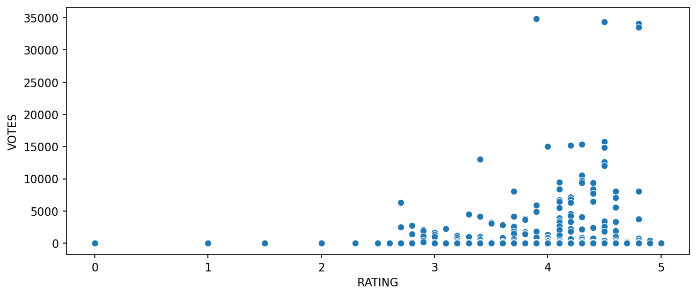
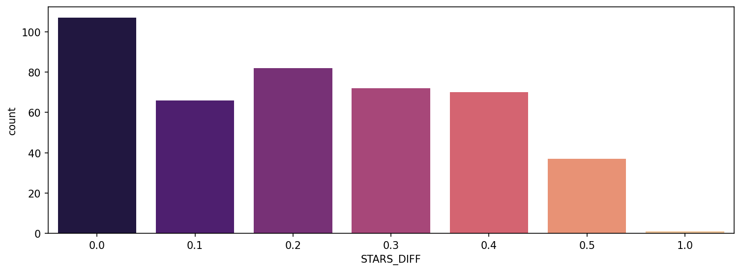
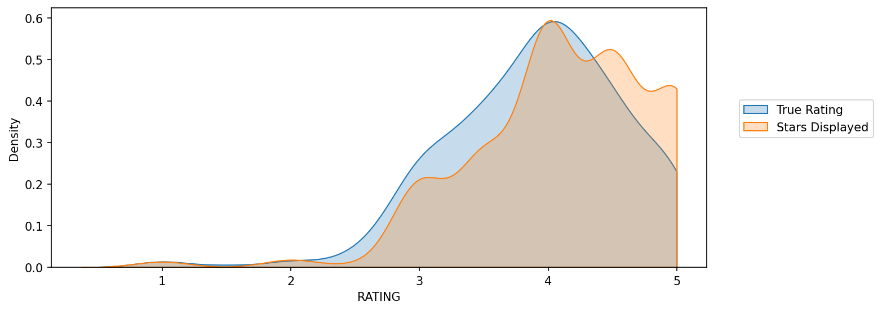
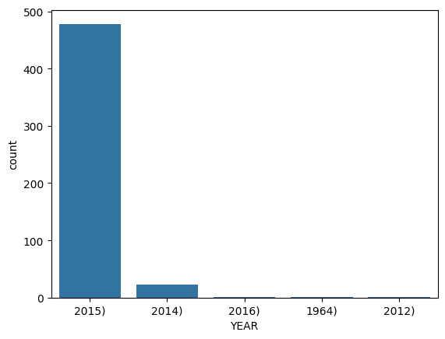
Result

Slide 13
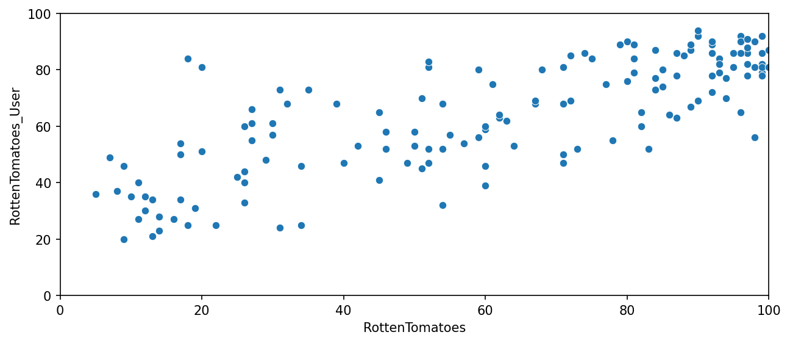
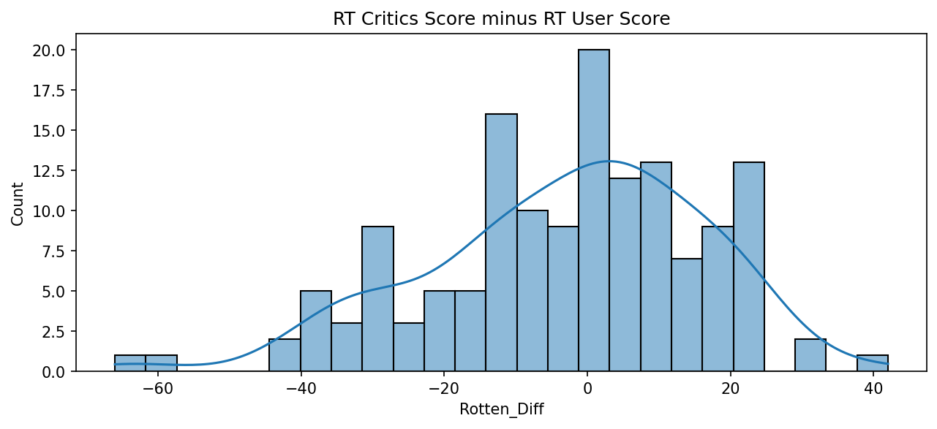
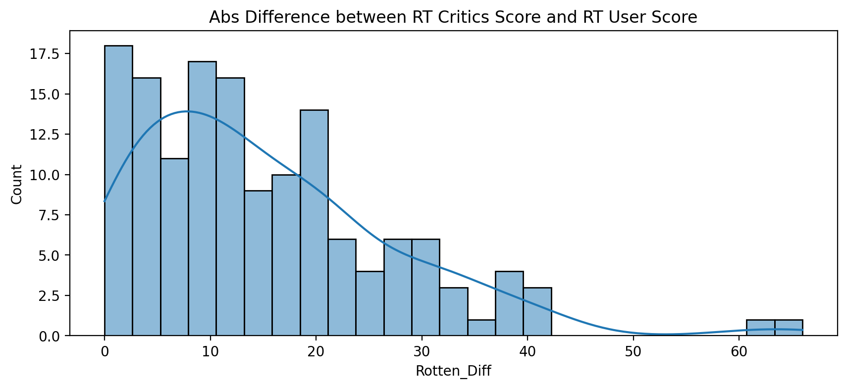
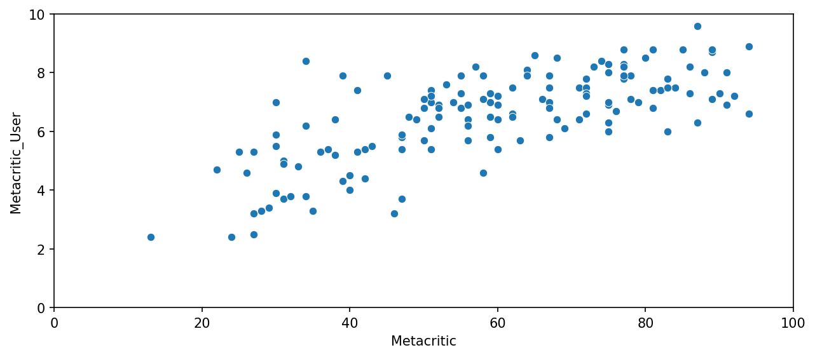
Result

Slide 14
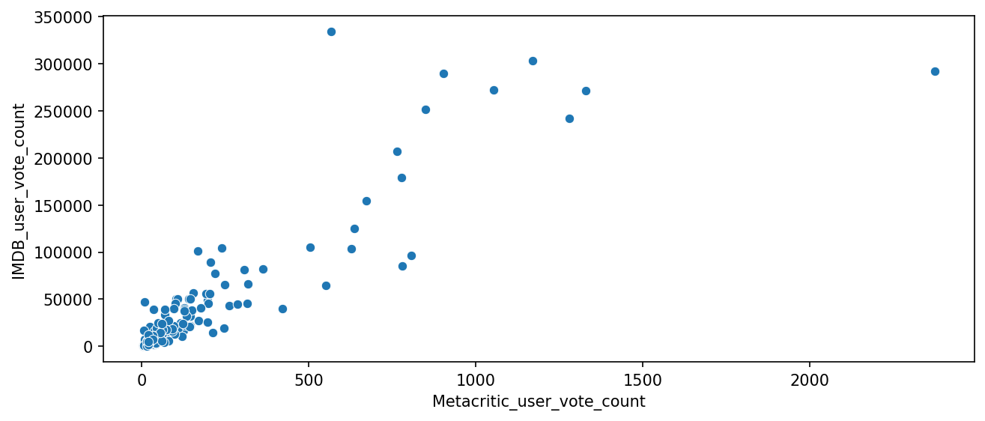
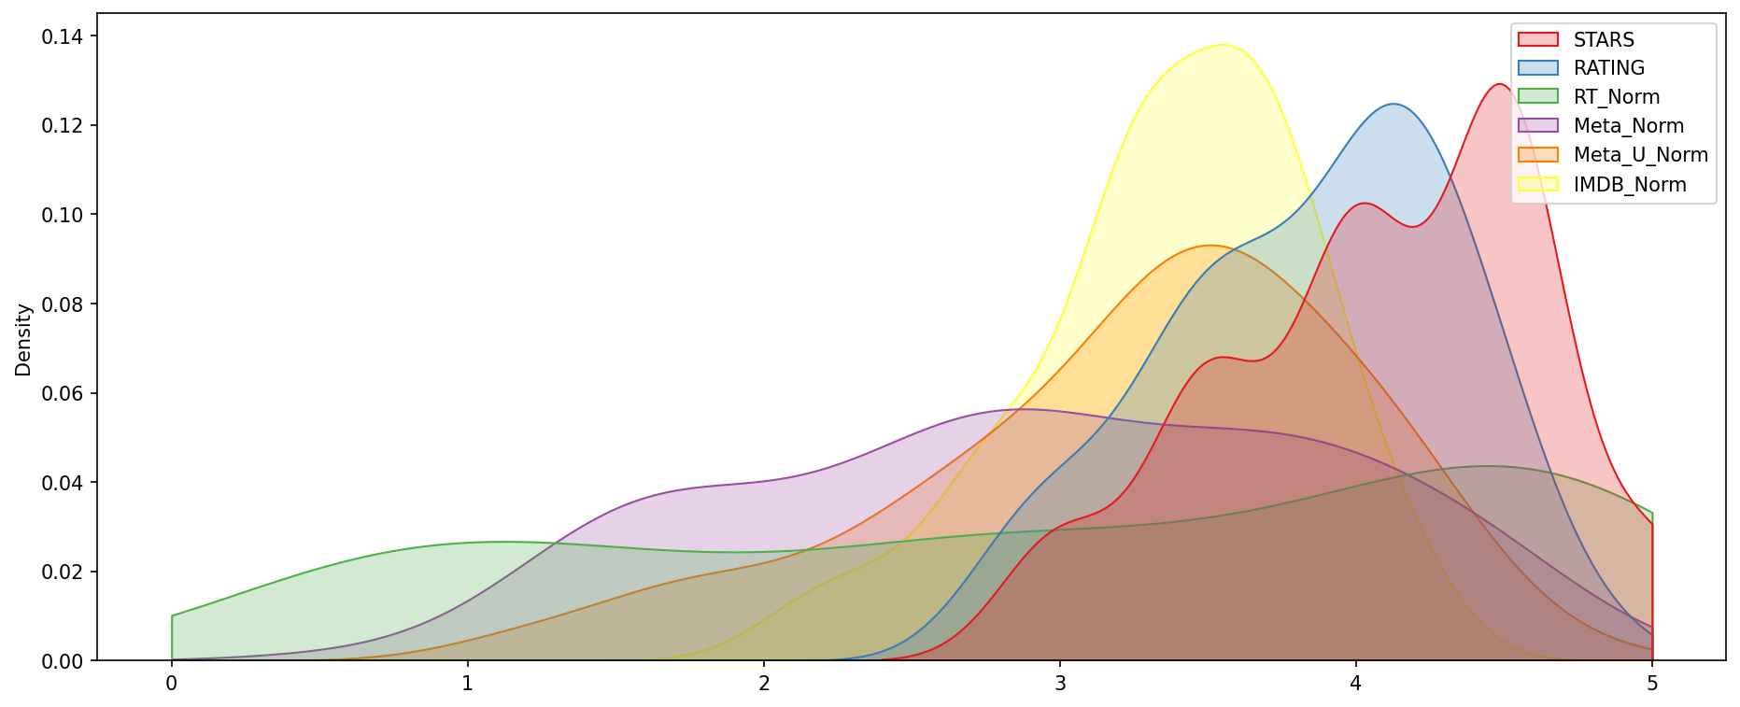
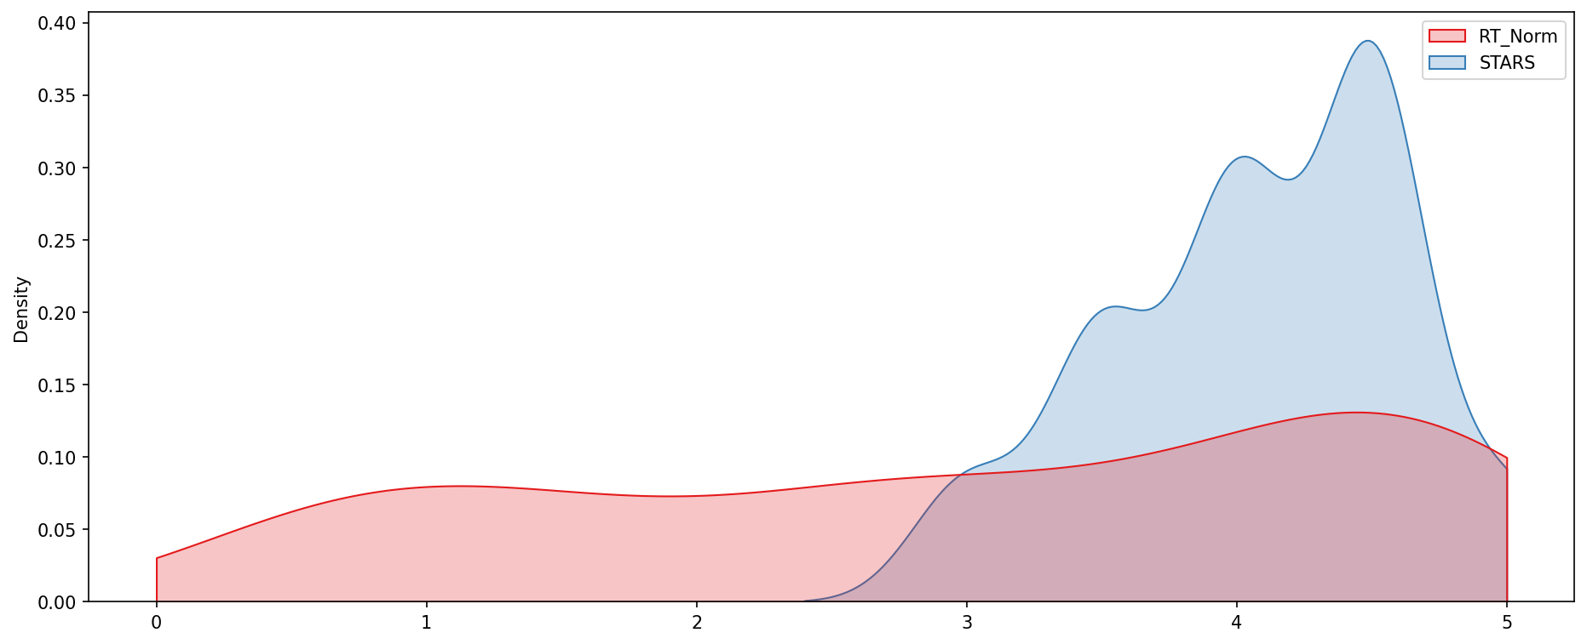
Result

Slide 15
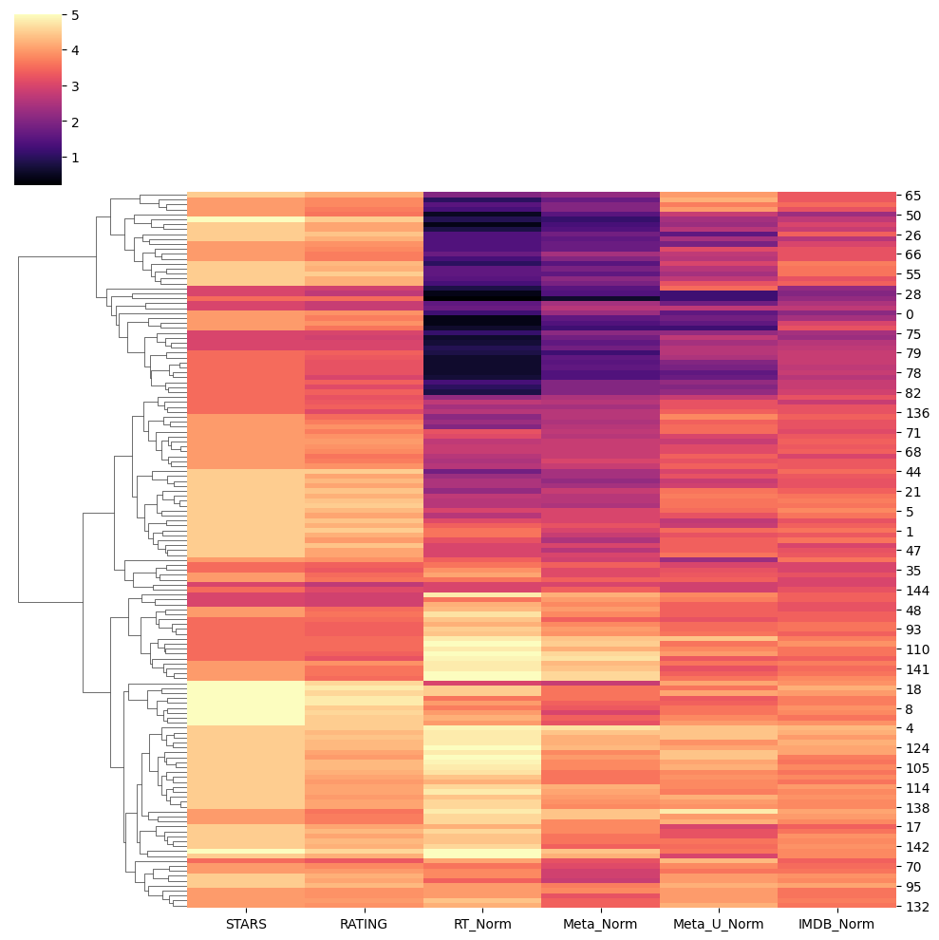
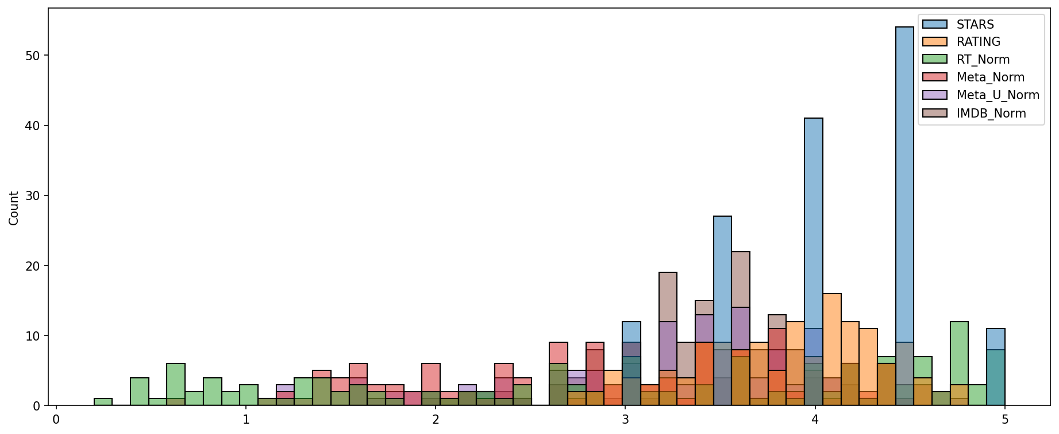
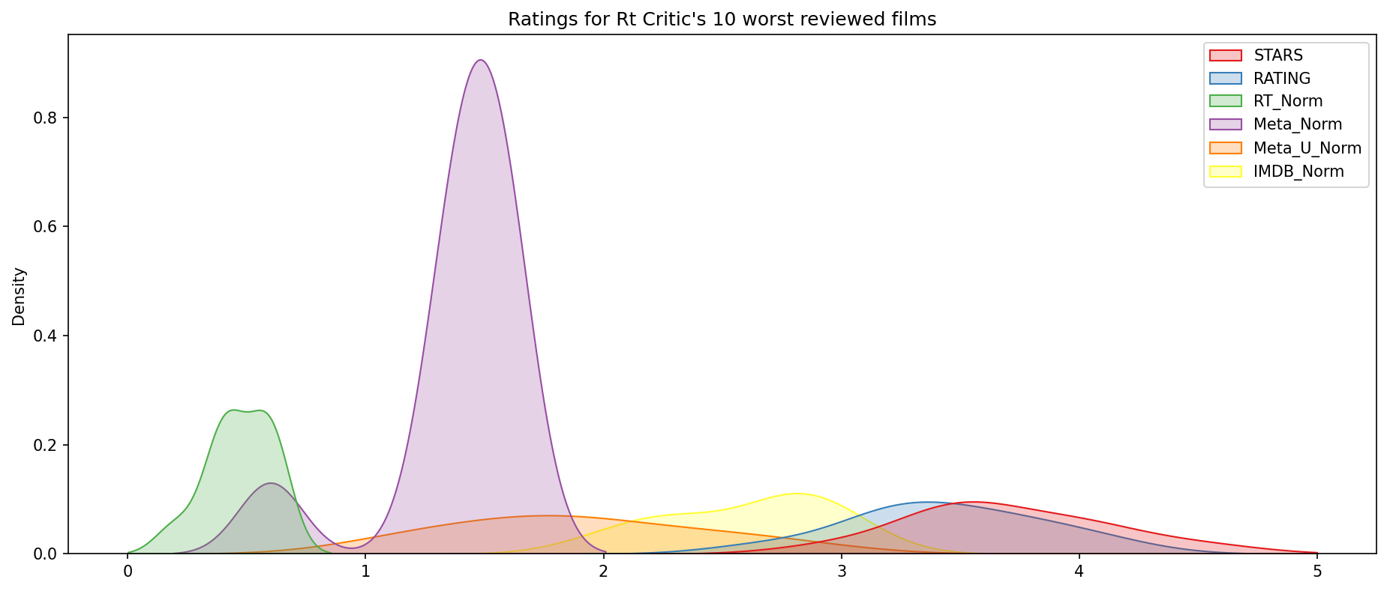
Result

Slide 16
Conclusion
In conclusion,The investigation raised questions about the accuracy and transparency of Fandango’s movie ratings. It’s essential for users to be aware of these discrepancies when relying on Fandango’s ratings for movie choices

Slide 17
Future scope
Collect and analyze more recent data (post-2016) to assess whether Fandango’s rating system has evolved.
Investigate whether the discrepancies identified in the past still persist or if there have been any improvements.
User Reviews and Sentiment Analysis:
Incorporate user reviews and sentiments from platforms like IMDb, Rotten Tomatoes, and Metacritic.
Perform sentiment analysis to understand how users perceive movies rated by Fandango.
Machine Learning Models:
Build predictive models to estimate Fandango ratings based on other features (e.g., genre, cast, release date).
Evaluate the accuracy of these models and compare them with actual Fandango ratings.
Transparency and Communication:
Encourage Fandango to be more transparent about their rating methodology.
Engage in dialogue with Fandango to address any discrepancies and improve rating practices.
Collaboration with Industry Experts:
Collaborate with film industry experts, statisticians, and data scientists to validate findings and propose solutions.
Seek insights from professionals who understand the intricacies of movie ratings.

Slide 18
References
https://www.Kaggle.com/datasets
https://pandas.pydata.org/pandas-docs/stable/user guide/index.html
https://seaborn.pydata.org/
https://matplotlib.org/stable/contents.html

Slide 19
THANK YOU

